Slide 1

L2 Sciences Alimentaires
Technique de communication Anglais
2021-2022
Cours N° 01
TEFFAHI Mustapha

Slide 2
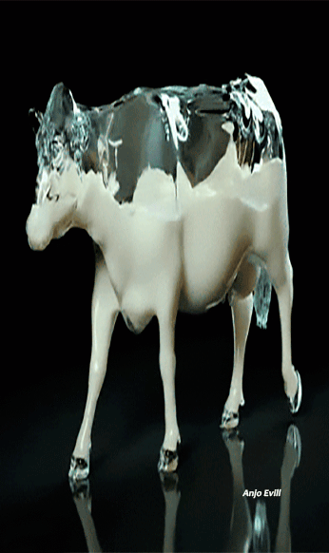
Cheese industry

Slide 3
Tasting cheese is an art. It is not for nothing that its letter of nobility appear on all the greatest tables and in all the greatest restaurants. Its success is such big that it is now ubiquitous in global gastronomy. Like us, are you also passionate and connoisseur of cheese , and the idea of opening the cheese factory of your dreams has already crossed your mind?
What could be better that being able to link dream and passion to proffesionnal future ?!

Slide 4
Conditions for opening a cheese industry:
Have either a diploma or training approved by the state in order to be able to market your product in the country.
Knowing the process of fabrication of cheese.
Minimum area of 200 m2 for your project achievement.
Respect hygiene rules, sterility of materials and wearing appropriate clothing in the industry.
Have a quality control department to control the product before exposing it in sales (physico-chimic factors , presence of germs…)
Have after-sales service (to listen to feedback and improve its product according to the consumer's choice)
Labeling of products by mentioning the date of manufacture and the expiration date.

Slide 5
CHEESE in general :
Milk: White liquid, opaque, very nutritious, secreted by the mammary glands of mammals. To preserve it ,there are different techniques the most important is transformation into cheese.
The name "cheese" is reserved for the product, fermented or not, ripened or not, obtained from the following materials of exclusively dairy origin: milk, partially or totally skimmed milk, cream, fat , buttermilk, used alone or mixed and coagulated in whole or in part before draining or after partial removal of the aqueous part.

Slide 6
What is fresh cheese :
a very wet dough.
little mineralized.
it is the product of a slow acid-dominant coagulation.
Obtained by the action of lactic acid bacteria combined or not with that of a small amount of rennet and a long incubation time.

Slide 7
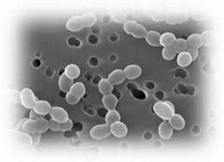
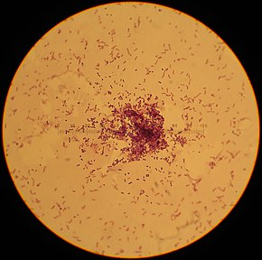
What is acid lactic bacteria ?
Lactic acid bacteria belong to a group of beneficial bacteria, whose virtues are similar, and which produce lactic acid as the end product of the fermentation process They help improve taste, appearance and safety. microbiological of the food.
Bacteria found in fresh cheese :
Leuconostoc spp lactococcus

Slide 8
Stages of making fresh cheese:

Slide 9
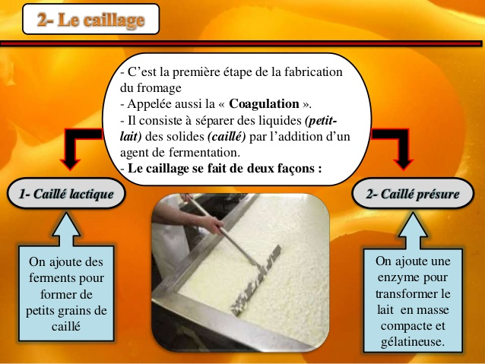
Knowing the fresh cheese-making process in details :
milk analyze :
Milk is a very perishable product and must therefore undergo numerous treatments in order to extend its shelf life.
pasteurization:
is done at a temperature of at least 62 C ° DURING A minimum period of 30 minutes.
The curdling :
This is the first step in making cheese.
Also called coagulation, it consists of
separating liquids (whey) from solids (curd)
by the addition of a fermentation agent
Curdling is done by adding ferments to form small grains of quail

Slide 10
Drainage :
During this phase, almost 80% of the water
contained in the curd is extracted.
During draining, a biological factor intervenes: acidification or "lactic fermentation", which generates porosity in the curd. . The milk is kept (from 12h to 48h) at t ° 15 ° C. During this time, the ferments develop, producing acidity (lactose becomes lactic acid). Lactic acid demineralizes the curd by removing much of its calcium, and therefore, of its flexibility. This gives a "lactic" curd, with high porosity which drains slowly and spontaneously.

Slide 11
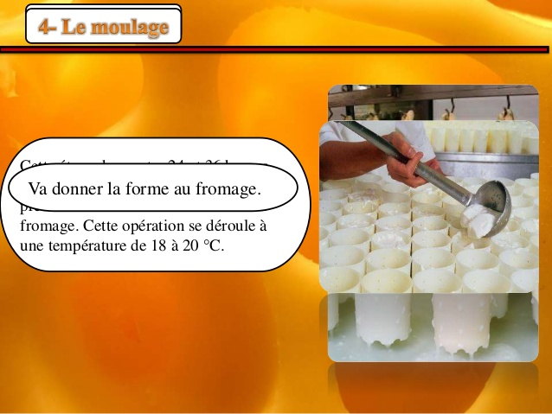
Modling :
cut to give the final shape of the cottage
cheese.

Slide 12
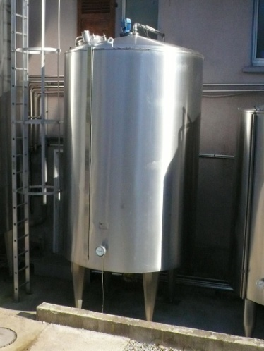
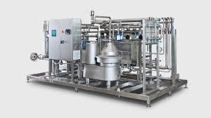
The equipment needed to open a cheese industry :
Bulk tank :
It is usually made of stainless steel and used every day
to store the raw milk on the farm in good condition.
It must be cleaned after each milk collection. It is used for
holding milk at a cold temperature until it can be picked
up by a milk hauler.
the milk pasteurizer :
It’s a material of preserving milk by heating to a temperature (between 62 and 88 ° C), for a defined time, followed by rapid cooling , and this to eliminate all the bacteria and microorganisms pathogen for man

Slide 13
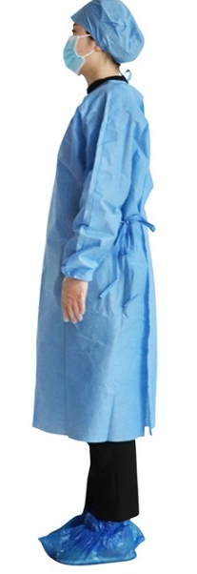
The material of curdling : it consist in separing liquid from solid
Laboratory equipped for milk analysis : microscope, glassware, reagents..ect
Quality control department
After-sales department
The stuff of packaging
sterilization material: autoclave ..ect
Personal medical protective equipment: to avoid contamination

