Slide 1

FOOD
COURS N°2
Master I Agroalimentaire et contrôle de qualité
Anglais scientifique
TEFFAHI MUSTAPHA

Slide 2
INTRODUCTION :
If food items are kept for a long period of time and not stored properly, they get spoil such food items are bad for health. When food items kept for a long time gets spoil as germs start growing on it. Once the food is spoiled, it cannot be eaten and has to be thrown away. Spoilage is a process in which food items deteriorate to the point in which it is not edible to human.

Slide 3
Causes of Spoilage
The food and water may be infected by germs. Flies carry germs. When they sit on our food, they pass on these germs to our food. There are various factors which are responsible for food spoilage such as bacteria, mould, yeast, moisture, light, temperature, and chemical reaction.
1. Bacteria: They are the most abundant microorganisms found on the earth. They are tiny in size and vary in shape. Some bacteria are useful also. They help to convert milk into curd.
2. Protozoa: They are single-celled microorganisms that cause disease like food poisoning etc.
3. Fungi: They are found in damp and warm places and grow on the dead and rotting matter.
4. Temperature: Temperature is one of the major factors which is responsible for food spoilage.

Slide 4
Signs of food spoilage
Signs of food spoilage include an appearance different from the fresh food, such as a change in color, a change in texture, an unpleasant odor or taste.
Activity I
• Aim: To study the growth of fungus.
• Materials: Piece of bread
• Method: Take a piece of bread. Make it moist and keep it in a warm corner of the room for 3-4 days. Observe it after 3-4 days.
• Observation: Presence of greenish patch growing on the bread.

Slide 5
Food Preservation
Food is valuable. Preserving food can help to avoid wasting of food. Food preservation involves preventing the food from being spoilt. Preservation of food is the process by which food is stored by special methods. Cooked or uncooked food can be preserved in different ways to be used later. Some methods of preservation are:
1. Freezing
Food kept in a refrigerator remains fresh for some days. Germs do not grow easily in cool places. We preserve food items, like milk fruit, vegetables and cooked food by keeping them in a refrigerator.
Activity II
• Aim: To understand the principle of food preservation.
• Materials: Two apples, fridge
• Method: Take two apples. Keep one apple in the fridge and one outside for 2-3 days. Record your observation.
• Observation: The apple inside the fridge is fresh while the one outside will start decaying.

Slide 6
2. Boiling
By this method, we can preserve food for a short period of time. Germs in milk are killed by pasteurization. It is done by boiling milk for sometimes and then cooling it quickly.
3. Salting
We can add salt to preserve pickles and fish.
4. Sweetening
Excess sugar in food also acts as a preservative. We store food for a long time in the form of jams, jellies, by adding sugar.
5. Dehydration
In this method, the food items are dried in sun to stop the growth of bacteria in them. Certain foods, like raw mangoes, fishes, potato chips are preserved by this method.
6. Canning
In this method, air is removed from food and put in airtight cans so that germs do not grow on them. Food items like vegetables, seafood, dairy products etc. Are preserved through this method.

Slide 7
Advantages and Disadvantages
• Advantages of food preservation: Germs do not grow easily in preserved food and make it safe to eat. Preservation enables us to enjoy seasonal fruits like strawberries and mangoes even during the offseason.
• Disadvantages of food preservation: Excess salt and sugar are used in the preservation of food which is not good for health. Some methods of food preservation may lead to loss of nutrients.

Slide 8
Questions
Q1. What is food spoilage?
Q2. What are the various methods of preserving food?
Q3. Write down disadvantages of preservation.
Q4. Give a suitable title to this course

Slide 9
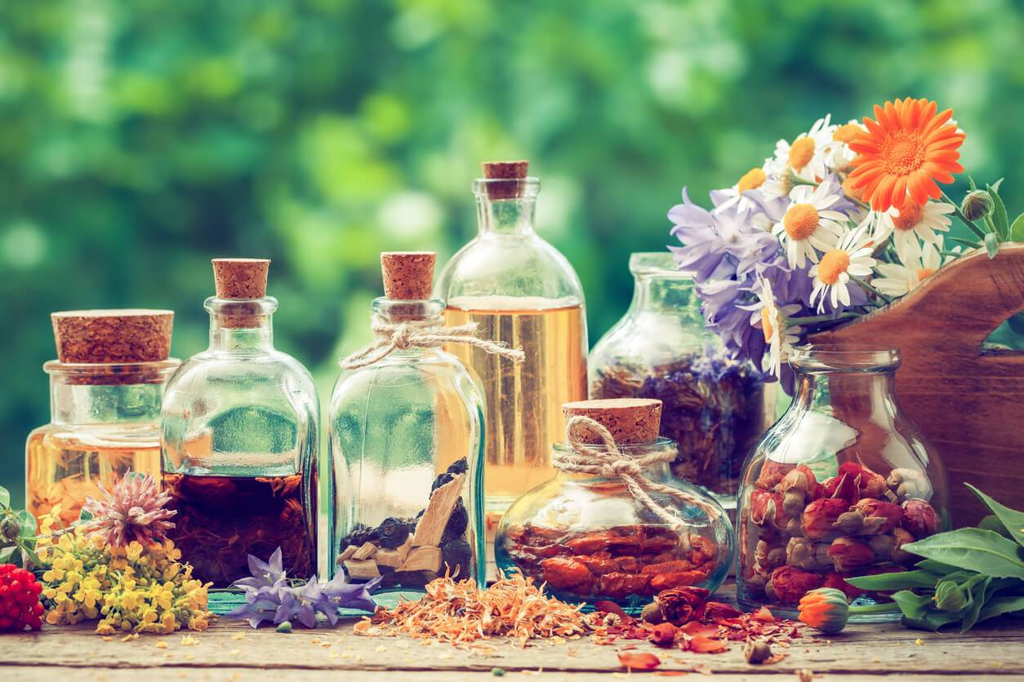
LA FIN DE VOTRE COURS N°2

