Slide 1

Jams and Jellies
COURS N°3
Master I Agroalimentaire et contrôle de qualité
Anglais scientifique
TEFFAHI MUSTAPHA

Slide 2
INTRODUCTION :
Jams and jellies are made from a variety of fruits, either singly or in combination. Most of the fruits are harvested in the fall. The level of ripeness varies. Pears, peaches, apricots, strawberries, and raspberries gel best if picked slightly underripe. Plums and cherries are best if picked when just ripe.
Sugar or high fructose corn syrup, or a combination of the two are added to the fruit to sweeten it. Cane sugar chips are the ideal type of sugar used for preserving fruit. Granulated and beet sugar tend to crystallize.
The element that allows fruit to gel, pectin is present in varying degrees in all fruit. Apples, blackberries, cherries, citrus fruits, grapes, quinces, and cranberries have the best natural gelling properties. Strawberries and apricots are low in pectin. Jams made from such fruits are either blended with fruits high in pectin, or extra sugar is added to the mixture. Sometimes pectin is extracted industrially from dried apples.
Citric acid is added to obtain the correct balance needed to produce the jam or jelly. Lime and lemon juice are high in citric acid, therefore they are the most prevalent source used. Other flavorings, such as vanilla, cinnamon, mint can be added to the jam or jelly.
The Manufacturing Process
The ingredients must be added in carefully measured amounts. Ideally, they should be combined in the following manner: 1% pectin, 65% sugar, and an acid concentration of pH 3.1. Too much pectin will make the spread too hard, too much sugar will make it too sticky.

Slide 3
-Inspection
When the fruit arrives at the plant, it is inspected for quality, using color, ripeness, and taste as guides. Fruit that passes inspection is loaded into a funnel-shaped hopper that carries the fruit into pipes for cleaning and crushing.
Cleaning, crushing, and chopping:
As the fruit travels through the pipes, a gentle water spray clears away surface dirt. Depending on whether the finished product is to be jam or jelly, paddles push the fruit and or just its juice through small holes, leaving stems and any other excess debris behind. Some fruits, such as citrus and apples may be manually peeled, cored, sliced and diced. Cherries may be soaked and then pitted before being crushed.

Slide 4
Pasteurizing the fruit
The fruit is heated to just below the boiling point (212° F [100° C]) and then immediately chilled to just below freezing (32° F [0° C]). This process, pasteurization, prevents spoilage. For jelly, the pulp is forced through another set of small openings that holds back seeds and skin. It will often then be passed through a dejuicer or filter. The juice or fruit is transferred to large refrigerated tanks and then pumped to cooking kettles as needed.
Cooking the jam and jelly
Premeasured amounts of fruit and/or juice, sugar, and pectin are blended in industrial cooking kettles. The mixtures are usually cooked and cooled three times. If additional flavorings are to be included, they are added at this point. When the mixture reaches the predetermined thickness and sweetness, it is pumped to filling machines.
Filling the jars
Presterilized jars move along a conveyer belt as spouts positioned above pour premeasured amounts of jam or jelly into them.
When

Slide 5
When the fruit arrives at the plant, it is inspected for quality, using color, ripeness, and taste as guides. Fruit that passes inspection is cleaned, crushed, and pasteurized. Next, the premeasured mixture is cooked with added sugar and pectin until it reaches the appropriate thickness and taste. Then it is vacuum-packed in jars and labeled.

Slide 6
Labeling and packaging
7 The sealed jars are conveyed to a machine that affix preprinted labels. According to law, these labels must list truthful and specific information about the contents
Quality Control
In the United States, food processing regulations require than jams and jellies are made with 45 parts fruit or juice to 55 parts sugar. The federal Food and Drug Administration (FDA) mandates that all heat-processed canned foods must be free of live microorganisms. Therefore, processing plants keep detailed lists of cooking times and temperatures, which are checked periodically by the FDA.
Requirements also exist for the cleanliness of the workplace and workers. Producers install numerous quality control checks at all points in the preparation process, testing for taste, color and consistency.

Slide 7
Question 1: Answer the following questions
Why sugar is added to fruit?
What are the types of sugar used during jam preparation? Why?
What is pectin used for?
Question 2: Give opposites of
Bellow
Full
Above
Sweet

Slide 8
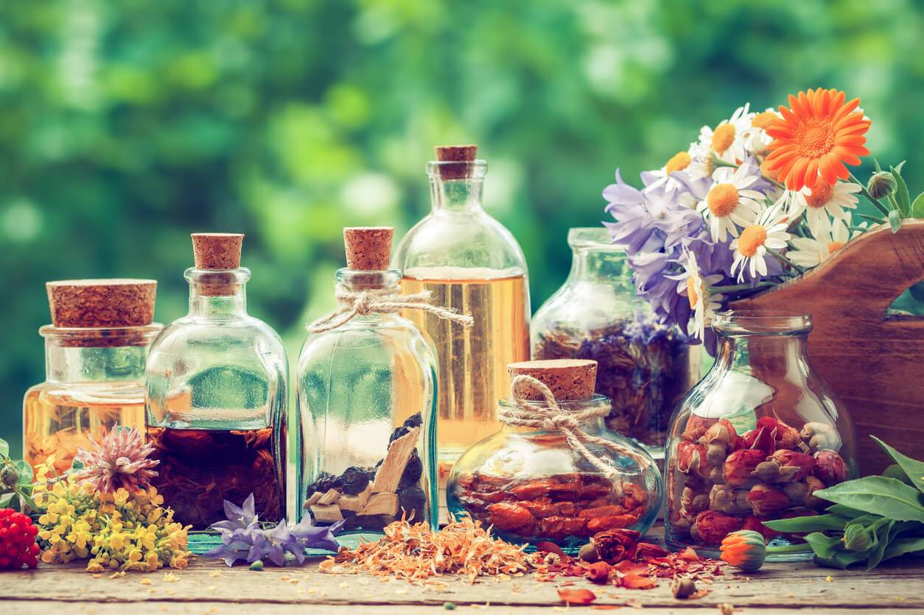
LA FIN DE VOTRE COURS N°4

