Slide 1

PHYTOTHERAPY
COURS N°3
Master I BIOCHIMIE DE LA NUTRITION
Anglais scientifique
TEFFAHI MUSTAPHA

Slide 2
INTRODUCTION :
Herbal medicine (phototherapy) : is the art of using plants for healing. From the Greek «phyton» which means plant and «therapein» which means to treat, it is therefore an allopathic therapeutic (that is to say to treat with substances which have the opposite effect to the pathology of which the patient suffers) intended for the prevention and treatment of functional disorders and benign medical conditions by non-toxic medicinal plants under normal conditions of use.
Man used plants to feed himself but also to heal himself. Over the centuries, knowledge of medicinal plants is passed down from generation to generation. The chemists managed to isolate the active ingredients of some plants , Continuing their research, they were able to manufacture synthetic molecules. The plants now serve only as reserves for chemical molecules. However, in recent years there has been a renewed interest in herbal medicine and more «natural» therapies. According to the WHO, 80% of the world’s population uses plants to treat themselves, in several forms: dried plants or not (herbal teas) or preparations immediately derived (powders, dyes, extracts, etc.). Herbal medicine has many benefits that would explain the return to its use.

Slide 3
-An active ingrédient :
Is an active substance obtained from vegetal organisms and used as a therapeutic or toxic means in medicinal preparations, drugs or poisons. By definition, the term active ingredient means a substance that has a certain biological activity, including all (beneficial) therapeutic substances such as drugs, vitamins and probiotics, or toxic (poisons).
II. Type of active ingredient of plants:
.1. Alkaloids: Alkaloids are naturally occurring molecules. They are found mainly in plants, but also in animals and some microorganisms , It can be found in all parts of the plant. alkaloids have significant pharmacological activity
the therapeutic interests of alkaloids:
Alkaloids are sought for their physiological effects, thus constituting substances of particular interest for their pharmacological activities in the most varied fields:
-alkaloids that act at the level of the central nervous system are either depurators ( morphine ) or stimulants (caffeine ) .
-the alkaloids involved in the autonomic nervous system are sympathomimetic or sympatholytic.
- Alkaloids also act as antibiotics such as cycloserine;

Slide 4
2.Flavonoids: Flavonoids are plant pigments of the polyphenols family that are responsible for the coloring of flowers and fruits. They often give a yellow coloring, Some flavonoids protect plants from bacteria, viruses and molds .
Therapeutic interests of flavonoids:
Activity of flavonoids against cancer: Among the most active flavonoids on tumor cells, we cite quercitrin and catechin which are very abundant in food. Quercitrine prevents carcinogenesis, especially skin and colon cancer. The presence of 20% quercitrine in the diet in animals decreases colon cancer and prevents the appearance of abnormal crypts.
5. Flavonoid Cardioprotective Activity: Flavonoids are known to have a protective effect on cardiovascular health by modifying several disease processes involved in the development of cardiovascular disease. These effects include, but are not limited to:
• Inhibition of free radical oxidation of LDL (bad cholesterol)
• Abolition of the tendency of small blood cells or platelets to regroup and form blood clots. This effect is often described as the “aspirin effect”.
• Regulation of inflammatory and immune responses in the blood vessel wall which may be abnormal in cardiovascular disease.

Slide 5
9. Role of flavonoids in eye protection: Some flavonoids, such as fisetin, have been tested for their protective effect against UV-induced oxidative stress in lens epithelial cells .
CONCLUSION :
There is no doubt that herbal medicine is effective in treating a number of pathologies and preventing others. Plants have the advantage of having very few side effects and practically no side effects , This is the best approach to prevent but also to treat the majority of our everyday ailments. Plants are a natural response to provide the body with the substances it needs to maintain its vital balance.

Slide 6
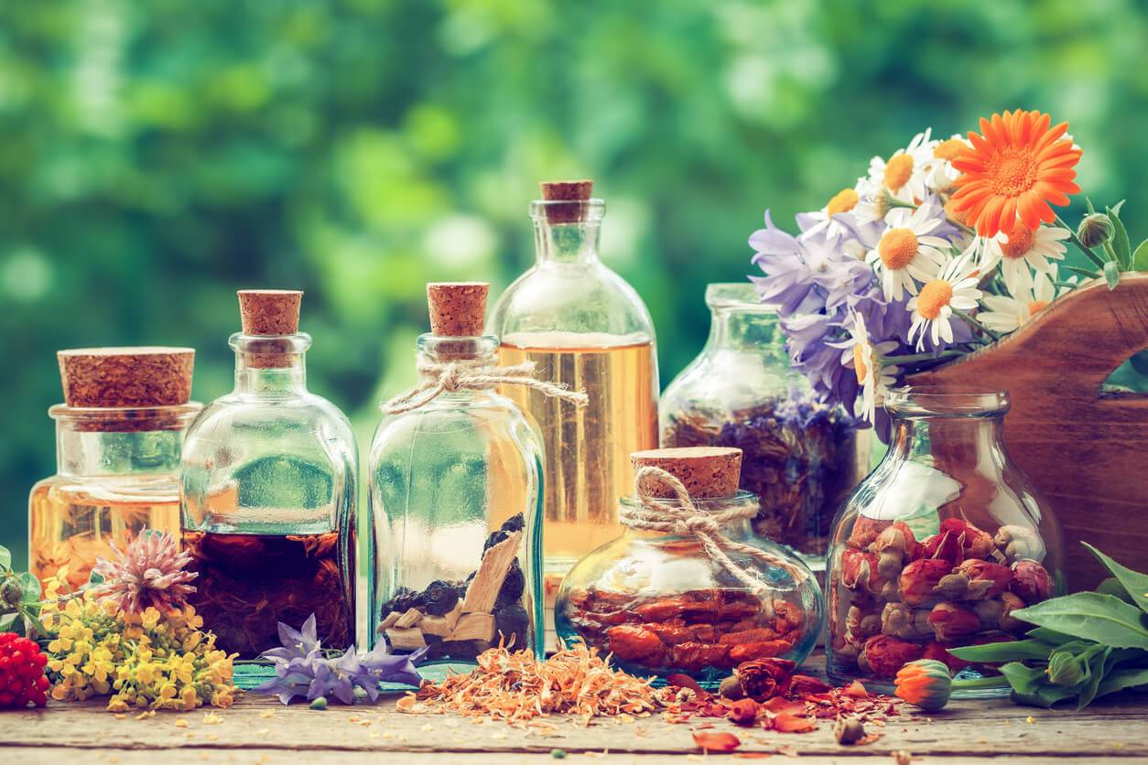
LA FIN DE VOTRE COURS N°3

