Slide 1
Romantic Poetry
Characteristics Of Romantic Poetry

Slide 2
Introduction
In the eighteenth and nineteenth centuries the Romantic movement made an early attempt at breaking away from « tradition » by laying the emphasis on the « spontaneity » of « natural art » , on the emotional nature of art , and of the genius of the artist himself , the poet was seen as the vehicle for spontaneous emotion , and poetry was described in terms of passion , and « inspiration » , Wordsworth reffered to poetry as ‘the spontaneous overflow of powerful feelings’

Slide 3
Romantic poetry
What is it ?
is the poetry of the Romantic era, an artistic, literary, musical and intellectual movement that originated in Europe toward the end of the 18th century. It involved a reaction against prevailing Enlightenment ideas of the 18th century, and lasted from 1800 to 1850, approximately

Slide 4
Characteristics of English Romantic poetry
There are many angles and point-of-views from which one can study romantic poetry. The most of important characteristic of this form of poetry is imagination. The different characteristics of romantic poetry are elaborated on in the article below

Slide 5


1)- imagination
Imagination In the words of William Wordsworth, 'poetry is the first and last of all knowledge'. The phenomenon of imagination is the essence or core of romantic poetry. According to romantic poets, it is possible to attain a transcendental experience by means of imagination. It takes us near to the spiritual truth ,related to morality, and they believed that literature, especially poetry, could improve the world. The secret of great art,

Slide 6
Blake claimed, is the capacity to imagine. To define imagination, in his poem "Auguries of Innocence", Blake said:
To see a world in a grain of sand,
And heaven in a wild flower,
Hold infinity in the palm of your hand,
And eternity in an hour.

Slide 7
2)- Nature
Love for nature is another important feature of romantic poetry, as a source of inspiration. This poetry involves a relationship with external nature and places, and a belief in pantheism. However, the romantic poets differed in their views about nature. Wordsworth recognized nature as a living thing, teacher, god and everything.

Slide 8
These feelings are fully developed and expressed in his epic poem The Prelude. In his poem "The Tables Turn" he writes:
One impulse from the vernal wood
Can teach you more of man,
Of moral evil and good,
Than all sages can.

Slide 9

3)- emotions
When it comes to romantic poetry, reason and logic take a backseat. The one thing which rules the world of romanticism is emotion. Romantic poetry is one of the best means to let loose one's emotions through words. The overflow of emotions depicted through romantic poetry transcends the boundaries of logical reasoning. Spontaneity in romantic poetry arises from an emotional outflow, and sometimes pain is the inspiration

Slide 10
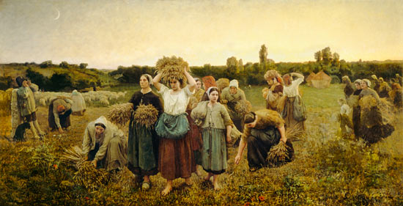
4- The pastoral life
The pastoral life, culture and traditions are mentioned on a frequent basis in romantic poetry. In most cases, the relaxed and slow-paced pastoral life of shepherds is depicted in these poems. Romantic poetry employs this feature in order to present before readers the complexities of life in a simple manner. Contrasting features of country and urban life can also be depicted by the portrayal of pastoral life.

Slide 11
5)- Symbolism
It is a way of expressing so much in so little. The use of symbolism in literature allows to infer / derive different meanings from a single expression. Symbolism rouses the curiosity of readers and also adds a kind of enigma to the expressions or thoughts of the poet. Representing a particular thing allegorically, lies at the core of symbolism. Repetitive presentation of an object or character is one of the ways in which symbolism is depicted in poetry

Slide 12
6)- Individualism
It is one of the important romantic poetry characteristics. Representation of a hero, a person with exceptional genius, is of common occurrence in romantic poetry. Heroes are depicted as personalities which exhibit boldness. This quality boldness is in contrast with that of restraint depicted in ancient classics. The use of romanticism in literature appeals to our dreamy inner-self. It helps us transcend the boundaries that are set by rational thinking. It helps us understand the wholesome truth instead of just making conclusions on what we see or derive by logical reasoning. There are so many things in this world beyond our understanding. We can say that the urge to known the unknown is expressed in the form of romantic poetry

Slide 13
7- Melancholy
Melancholy is a major source of insipration for the romantic poets , due to extreme melancholy , all the romantic poets have a tendency to compose subjective poetry . Keats wrote :
..........for many a time
I have been half in love with easeful Death
,Call’d him soft names in many a mused rhyme,
To take into the air my quiet breath;
Now more than ever seems it rich to die,
To cease upon the midnight with no pain.

Slide 14
Thank you

