Slide 1
A work by:
Mekki Dinokhalil
&
Bahloul Mohamed Amine
Inspected by:
Dr. Meskini

Slide 2

Novella by the title of:

Slide 3
Index:
Insight on Joseph Conrad
Overview on Heart of Darkness
Elements of the Novella
Setting
Characters
Plot
Themes
Literary Style
Critics and Reception

Slide 4
Insight on Joseph Conrad:
Born in 1857 in the Polish Ukraine under the name of Jozef Teodor Konrad Korzeniowski. Conrad had a troublesome childhood in which he lost his mother at a young age and was exiled with his father to Siberia after the latter was being suspected of plotting against the Russian government. He was sent to his mother’s brother to receive his education. At the age of seventeen, Joseph Conrad travelled to Marseilles to then spend the next 20 years as a sailor.
In 1889 he began writing his first novel (Almayer’s Folly) while actively trying to fulfil his boyhood dream of traveling to Congo which was made possible through his acquiring of the commanding of a steamship in Belgian Congo in 1890; a mentally disturbing voyage that would later on serve as the founding basis of his most renowned novella, Heart of Darkness.

Slide 5
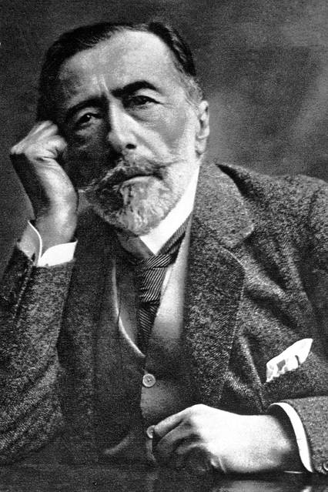

Slide 6
Overview on Heart of Darkness
After its first hesitant publishing- due to Conrad’s doubtfulness for what seemed good reasons at that time, in Blackwood’s Edinburgh Magazine in 1899, the novella was re-published in Conrad’s Youth: and Two Other Stories in 1902. This work all in all served as a semiautobiographical depiction of what the author experienced in the “darkness” of the Congo jungles through the eyes of a protagonist that, to say the least, was facing the trials and tribulations of an era that could torment the mental stability of any individual; hence, Heart of Darkness.

Slide 7
Elements of the Novella:
Setting
Characters
Plot
Themes
Literary Style

Slide 8
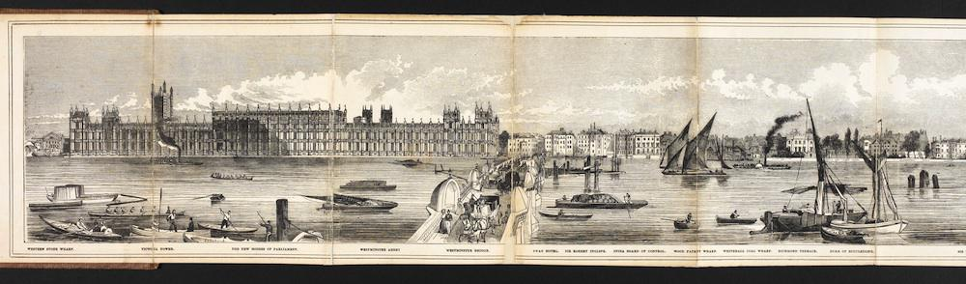
Setting:
The story is set on various locations starting on a boat floating on the River Thames
with Charlie Marlow, the protagonist, and a group of passengers to whom he reminisced a turbulent tale from his past; which starts on the “sepulchral city” somewhere in Europe to then reach his destination, the Rivers and Jungles of the Belgian Congo. The story however concluded with Marlow back in England.

Slide 9
Plot
As in the aforementioned starting line of the story in the Setting section, Charlie Marlow tells the tale of his horrific journey that occurred in the jungles of the Belgian Congo, all in purpose of meeting the man that was the sovereign of that destination- a tyrant by the name of Kurtz who ruled with an iron fist and no regard to the native “cannibals”, as described by the psychologically flawed protagonist, an ideology somewhat equally portrayed in the Western Civilization’s Imperialism. After finally encountering the man that left behind nothing but cruelty and barbarity, Marlow had no choice but to force the mentally ill Kurtz to return back with him on his steamer. Plans do not work accordingly however, when Kurtz’s camp is attacked by ‘savages’ as described in the story, but luckily with the aid of a crazy Russian as referred to and the ‘God’ (self-proclaimed of being for Kurtz) figure of those regions, they manage to leave unscathed but at the cost of worsening Kurtz’s condition. Although the mad-man had every intention of remaining in the jungle as its only governor, Marlow managed to drag him along in his journey back to Europe, but only to witness his death in the midst of the voyage.
‘The Horror! The Horror’ were Kurtz’s final words uttered to a perplexed Marlow that whimsically changed that narrative to the deceased’s intended in England; her name is what Marlow said was Kurtz’s last thoughts left behind. Charlie Marlow’s story ends there, but for the novel’s, it is the upcoming gloom in the shape of clouds waiting to envelop London in ‘Darkness’.

Slide 10
Characters
Marlow:
As perhaps the mirror of Conrad himself, the protagonist serves the role of a mediator between two extremes, Kurtz and the company, in a world of Imperialism and chaos, but also in a Modernist era where the protagonist relies on his intelligence, shaky philosophy, and overall sense of doubt. Although defeated and pursued with the many challenges of his voyages, Marlow still is able to, time and time again, find himself in the face of what he encountered before, whilst, and even after meeting a man such as Kurtz.
Kurtz:
Portrayed as the typical archetype or antagonist of any story of its genre, the characterization of this man speaks for itself. Ingenious, ferocious, unstable, and all in all what maybe truly represented the ideals and concepts of the Western civilization at that troubling period of time. Kurtz also was a manifestation of others’ images of him; from Marlow, the Russian crazed man, and even his intended, as they all individually painted in the canvas of what ultimately became known as the Kurtz that eventually died in the middle of a jungle where he saw himself belonging.

Slide 11
Kurtz’s Intended:
For all what it’s worth, Conrad did not give as much narrative and character to his female cast as he did with their male counterpart. Though she held no name in the story- as is the case for Kurtz’s mistress in the Belgian Congo settlement- the fiancée did hold the value of putting closure to her beloved’s story and life in some sort, and perhaps to some extent Marlow’s as well, as she ‘seemed as though she would remember and mourn [Kurtz] forever.’

Slide 12
Themes
Imperialism:
As probably the theme most controversial and widely explored in the novella, Conrad was ironically successful in really depicting the horrors that were brought about by the colonial raids and ventures of the Western world in the African continent and towards its natives especially. The imperialistic ideal is well conveyed through the eyes of: Kurtz in the atrocities that he committed upon the inhabitants of the numerous regions he swepped under his rule; and Marlow’s vision of the African helmsmen and natives that only fitted his needs and wants as either machinery on board his ship, or ‘luxuries of life’ that the native females provided. This concept took a toll on even the psyche of the characters throughout the story in the form of madness and contradiction if their own beliefs.

Slide 13
Contradiction & Ambivalence:
As a very prevalent theme in the novella, it was perhaps more present in the views and ideals of the main character- Charlie Marlow. Whether it be how he does not necessarily view Imperialism as evil but more so as eye-opening for the ‘savages’ that lived in the jungles of Congo; or how he wanted to protect and preserve the women’s awareness from the cruelty of the world, yet describe how naive and sheltered they can be in general. The end of the novella is in and of itself a contradiction best made sense of in Marlow’s words of life being ‘merciless logic’ and at the same time ‘futile purpose’.

Slide 14
Hollowness:
Marlow’s journey is filled with people that are all form but no substance and content, and that may have been ironically best shown in the man he sought after in his journey- Kurtz. Although late, Marlow realized just how hollow Kurtz is after observing firsthand his violent and ill behavior that seemed to serve no purpose at all; the several raids on the regions, the severed heads of the natives that surrounded the fences of the Stations, and all his flamboyant talk about his ‘immense plans’ were ultimately empty shells that served no goal in the eyes of Marlow.

Slide 15
Literary Style
In Heart of Darkness, Joseph Conrad employs stream of consciousness narration which is a feature of Modernist experimental literature. He narrates his story in a very descriptive manner according to the consciousness of the narrators (Marlow and one of his audience) –interior monologues- in a non-linear fashion just how they appear in their minds. The implementation of Allusion (White Sepulchral), Symbolism (evil of Imperialism, cruelty of the world,…) Allegory (Kurtz’s descent towards madness being a reference to Imperialism) and the many uses of imagery that described best the rough nature of the African jungles and the struggles that the characters faced whilst there.

Slide 16
Critiques
Although popular and regarded as Conrad’s most acclaimed work to some extent, Heart of Darkness did have its fair share of criticism and rightfully so. Besides the fact that novella is purely written from a white male misogynistic viewpoint, the treatment of the African natives was not to be taken lightly which was the case with Chinua Achebe’s Things Fall Apart mentioning how dehumanized were the natives; albeit in favor of degrading the imperialistic nature of the Western world.
In a similar fashion, the feminine discourse also had its right for critiquing how little was the importance given to the female cast that was supposed to be more highlighted and explored due to the simple fact of their relation with the protagonist and antagonist.
Regardless of the shortcomings of the novella, and taking in mind the ambiguous linguistic features implemented, Heart of Darkness still hold value of being the perfect example of both what a Modernist composition really is, and how it depicted the social and individual values and themes of said era.

