Slide 1

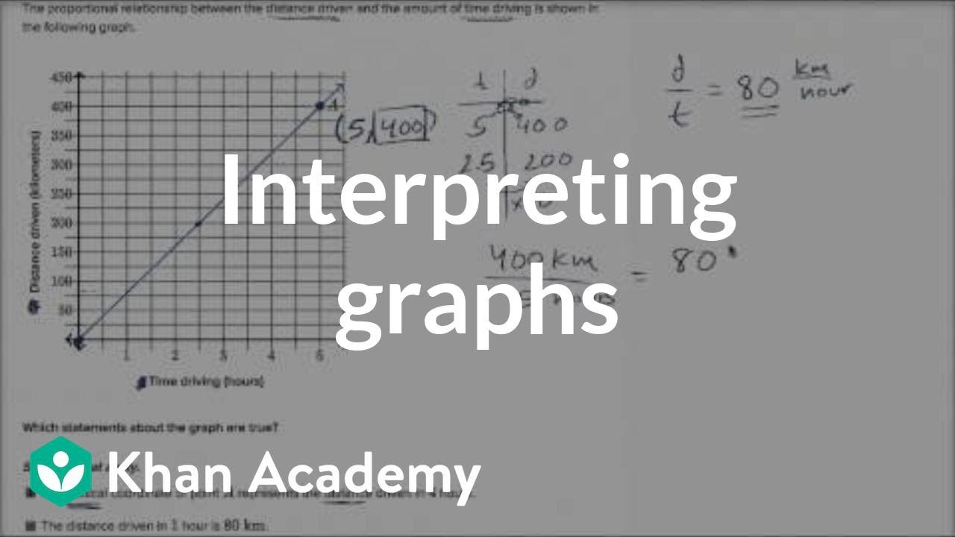
COURS N°2
MASTER I BIOCHIMIE DE LA NUTRITION
ANGLAIS SCIENTIFIQUE
TEFFAHI MUSTAPHA

Slide 2
Why use graphs?
Graphs are useful in indicating trends, including how one aspect, or variable, changes in relation to another. For example, a graph might show: How an insect population increases or decreases with seasonal temperature or rain fall?
Drawing graphs
A graph has two axes, horizontal and vertical. Each axis is divided into equal measures and labelled to specify the unit of measurement being used, such as “weight in grams”, “volume in liters”, “or “temperature in degree celcius”

Slide 3
Introducing the graph
To introduce your graph, you could use one of the sentences below, The graph/table/pie chart/bar chart/diagram ...
• gives information about/on ...
• provides information about/on ...
• shows ...
• illustrates ...
• compares ...
• explains why ...
• describes ...
draws the conclusion of (a survey) ...

Slide 4
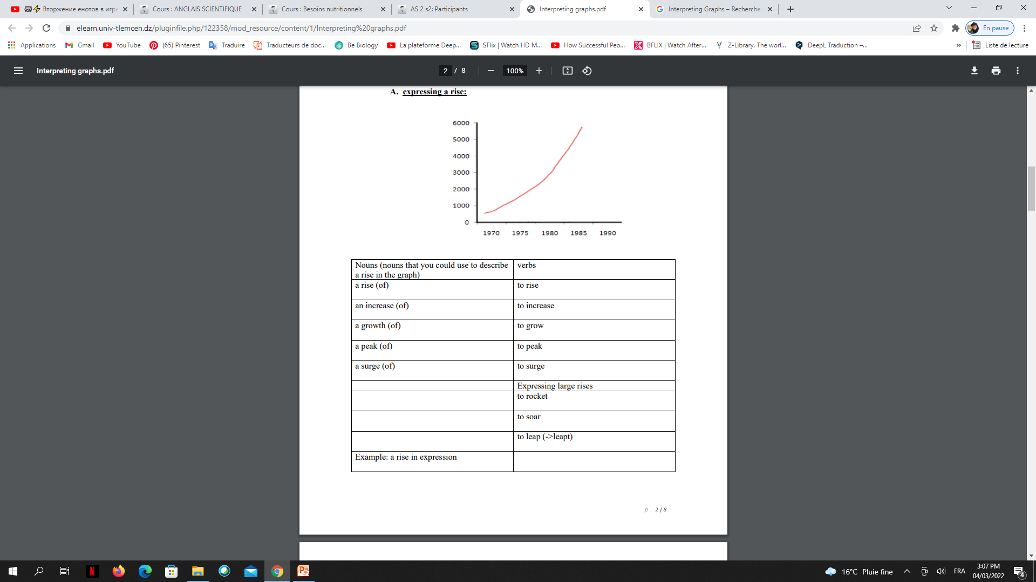
Types of changes
A. expressing a rise:

Slide 5
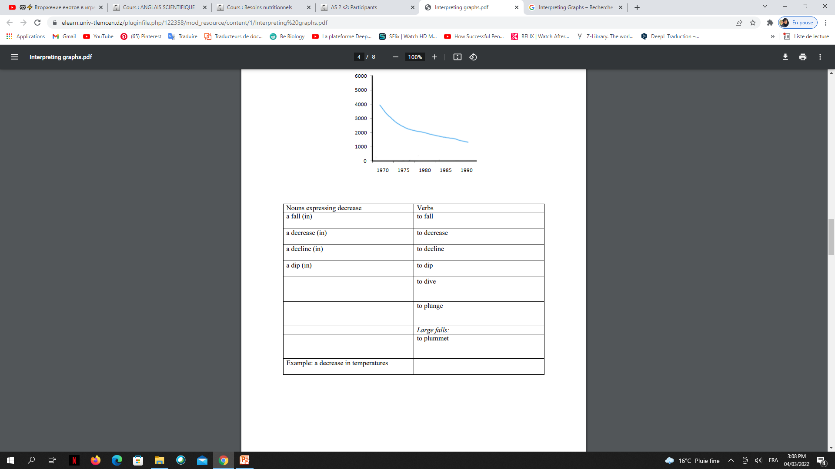
B. expressing a decrease:

Slide 6
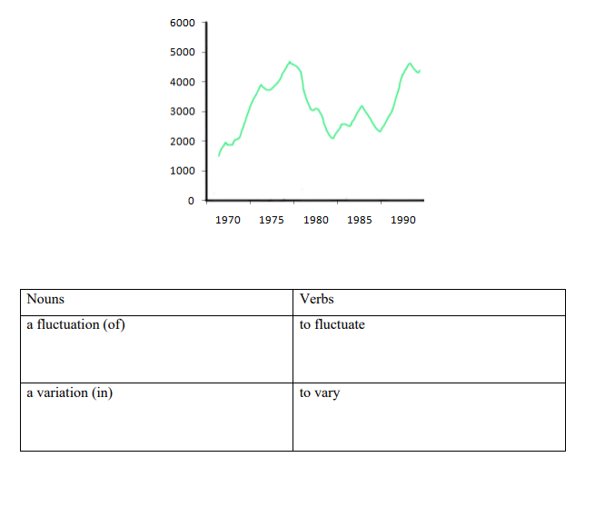
C. expressing a variation:

Slide 7
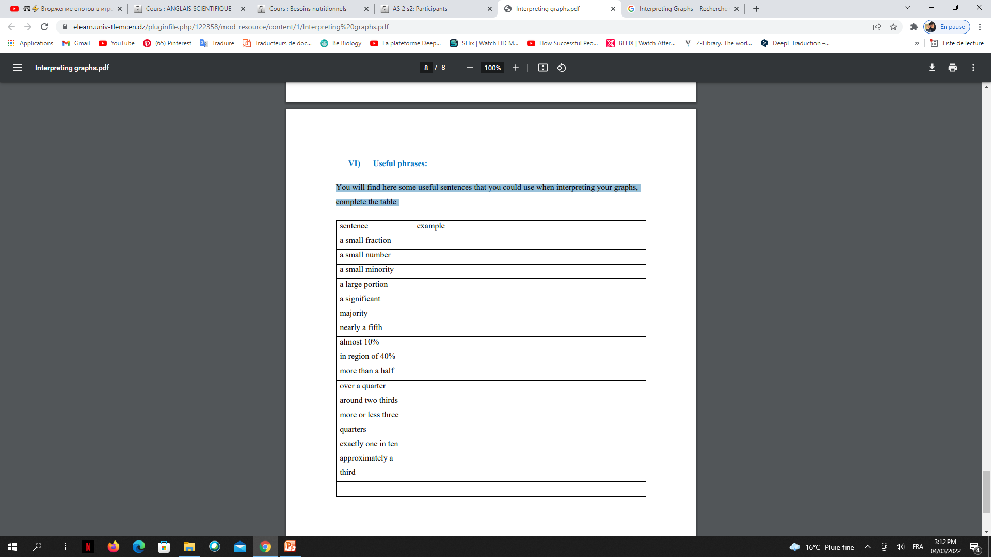
Useful phrases
You will find here some useful sentences that you could use when interpreting your graphs, complete the table

Slide 8

LA FIN DE VOTRE COURS N°3

