Slide 1

COURS N°4
MASTER I BIOCHIMIE DE LA NUTRITION
ANGLAIS SCIENTIFIQUE
Questions to ask in order to understand a scientific article
TEFFAHI MUSTAPHA

Slide 2
Much of a scientist’s work involves reading research papers, whether it’s to stay up to date in their field, advance their scientific understanding, review manuscripts, or gather information for a project proposal or grant application. Because scientific articles are different from other texts, like novels or newspaper stories, they should be read differently.
Research papers follow the well-known IMRD format — an abstract followed by the Introduction, Methods, Results and Discussion, they are preceded by the Title and Authors (of the work), and ended by the Conclusion and References (some articles add Acknowledgements) They have multiple cross references and tables as well as supplementary material, such as data sets, lab protocols and gene sequences. All those characteristics can make them dense and complex. Being able to effectively understanding them is a matter of practice

Slide 3
1-Abstract
The Abstract is the best thing to read FIRST.
The Abstract portion of an article is a short summary of the article as a whole. It should include the focus and results of the study as well as ultimate conclusions drawn. It does not explain in full p. 2 any of the above, so it is important to use the abstract as a tool to decide if you should investigate further. (The Abstract is always available even when an organization does not have a subscription to a journal).
Question to ask:
• Does this interest me?
• Is this related to my area of research?

Slide 4
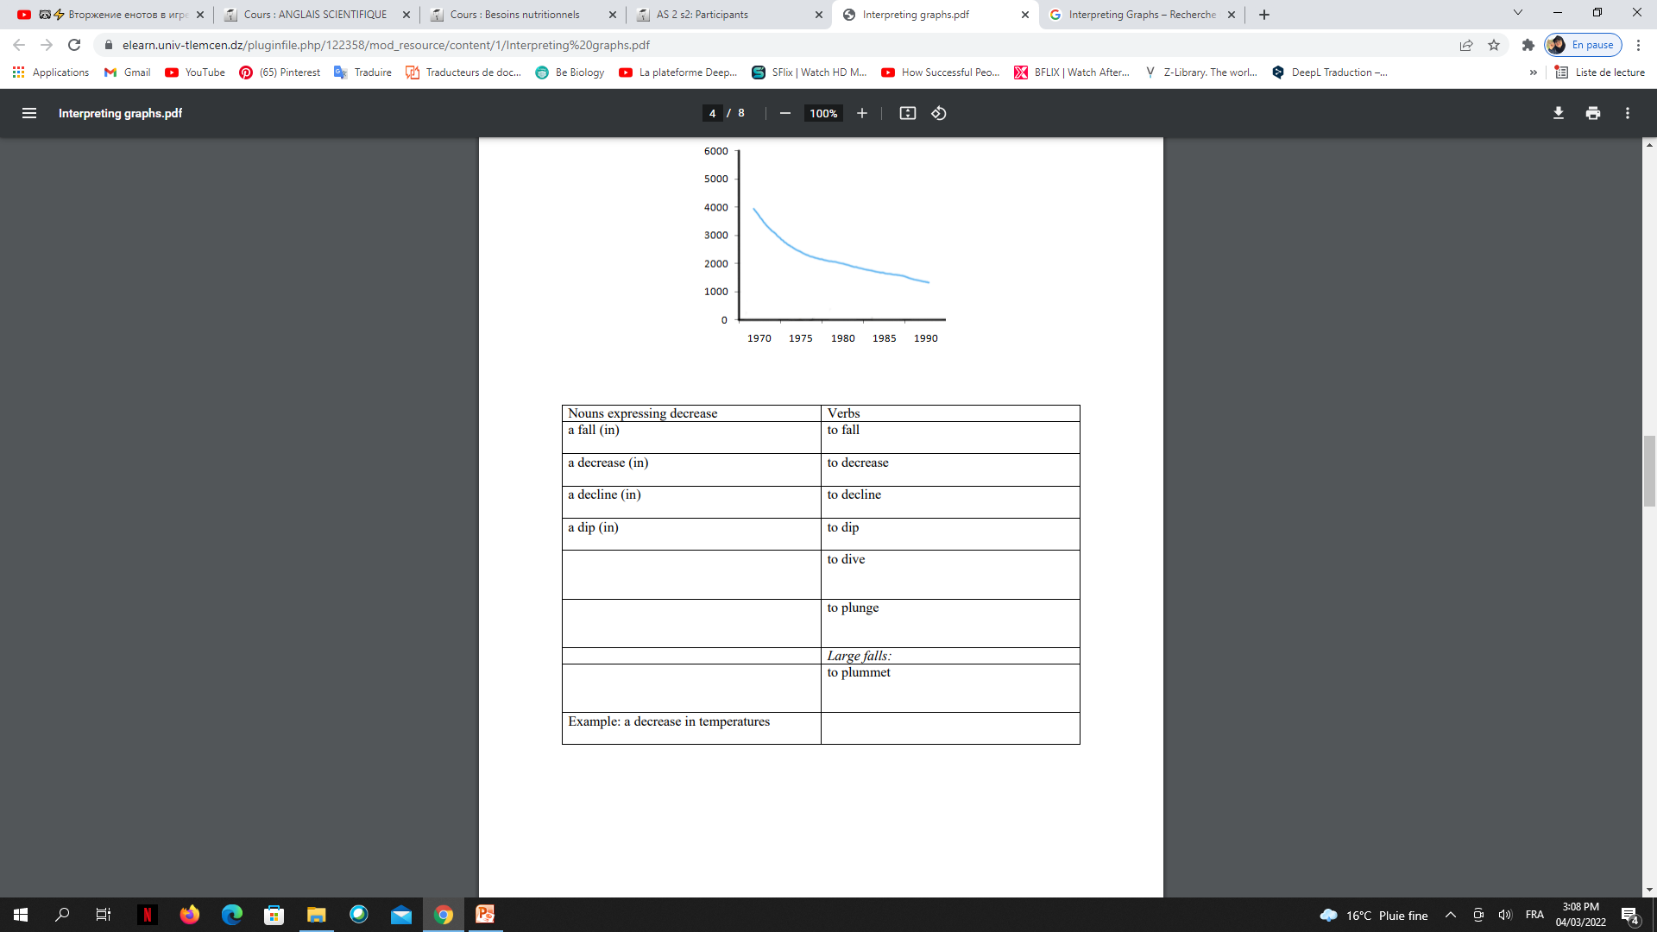
B. expressing a decrease:

Slide 5
1-Abstract
The Abstract is the best thing to read FIRST.
The Abstract portion of an article is a short summary of the article as a whole. It should include the focus and results of the study as well as ultimate conclusions drawn. It does not explain in full p. 2 any of the above, so it is important to use the abstract as a tool to decide if you should investigate further. (The Abstract is always available even when an organization does not have a subscription to a journal).
Question to ask:
• Does this interest me?
• Is this related to my area of research?

Slide 6
2- Introduction
The Introduction of a paper explains the idea investigated. It should include what many refer to as a "Literature Review", which is a summary of research already performed by others about the same topic. Here it should indicate why THIS particular study is unique or how it adds to the discussion.
Question to ask:
• What have other people done in regards to this topic?
• How is this research unique?
• Will this tell me anything new?

Slide 7
3- Materials and Methods
The Introduction of a paper explains the idea investigated. It should include what many refer to as a "Literature Review", which is a summary of research already performed by others about the same topic. Here it should indicate why THIS particular study is unique or how it adds to the discussion.
Question to ask:
• Could I repeat their work?
• Is all the information present in order to repeat it?

Slide 8
5-Discussion/Conclusion
The Discussion section of a research paper should tell you what the researchers felt was significant about the results. This is where they analyse the data. What did the data tell them? They may also point to facts and figures. p. 4 The Conclusion of a scientific paper tells you the final thoughts from the researchers. It may reiterate what they noted in the Discussion or it may even be combined with the Discussion. Many times the Conclusion recommends areas to be researched in the future.
Question to ask:
Does their analysis agree with the data present?
• What are the weaknesses in their argument?
• Is the conclusion valid?
• Based on what you have read, what other research should be explored next?

Slide 9
4- Results
The Results section of a research paper should tell you, in unbiased terms, what the findings were. The data should be included here. (Rarely the Results and Discussion sections will be combined).
Question to ask:
• Are the results presented in a factual and unbiased way?
• Is all the data present?
• What conclusions do you formulate from this data?

Slide 10
6-References:
The References section of the article gives credit to other scientists and researchers. It shows you what works the article you are reading referred to when planning their research and writing their paper. Any articles they mention in their Introduction or Literature Review should be present here. Any studies they modeled their Materials and Methods on should be included here.
Question to ask:
• What other articles should I read?
• What other authors are respected in this field?
References:
1-how to read a scientific paper, illinois university
2-reading scientific paper, elsevier

Slide 11

LA FIN DE VOTRE COURS N°4

