Slide 1
Literature
Miss Bendjilai

Slide 2
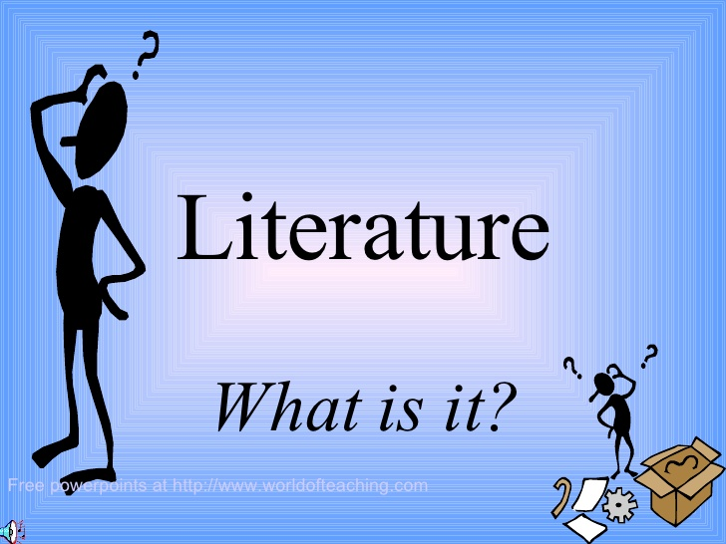

Slide 3
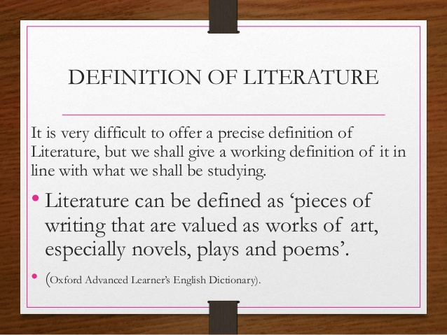
Definition of Literature

Slide 4
Literature « from latin Litterae » is the art of written works.
Literally translated , the word literature means « acquaintance with letters ».

Slide 5
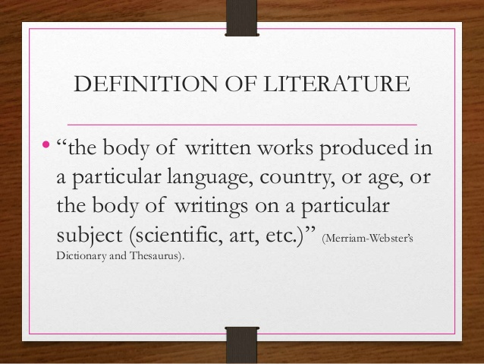

Slide 6
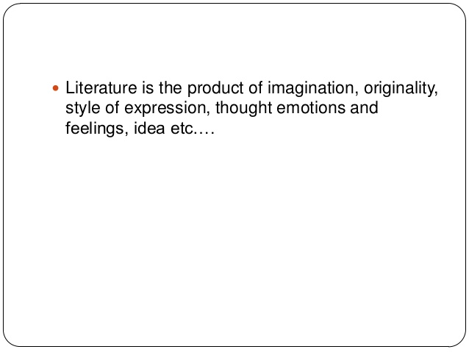

Slide 7
Two kinds of literature
1.Written works: novel; novella poetry;newspaper,magazines;essays……..
2.Oral works: Music ; Jokes;myth…..

Slide 8
Importance of Literature
.Reading and studying Literature is very important for various reasons as outlined below:
1.Literature improves your command of language It teaches you about life, cultures and experiences of people in other parts of the world.

Slide 9
2. It gives you information about other parts of the world which you may never be able to visit in your lifetime
3. . It entertains you and provides useful occupation in your free time.
4. . It gives information which may be useful in other subjects, for example, in Geography, Science, History, Social Studies, and so on

Slide 10
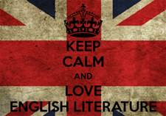
An introduction of British literature

Slide 11
Definition of British literature
*is the study of literature written in the English language. The writers do not necessarily have to be from England but can be from all over the world.

Slide 12
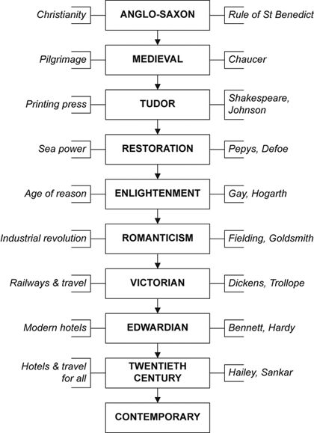

Slide 13
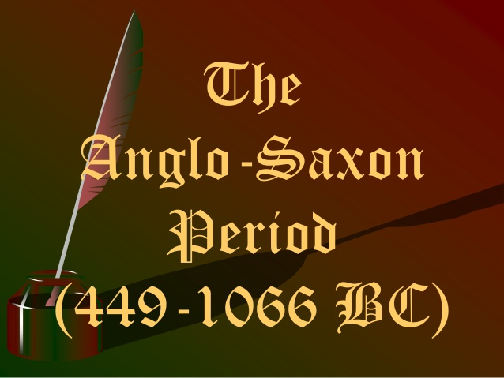

Slide 14
The invansion of England
A brief introduction of British history

Slide 15
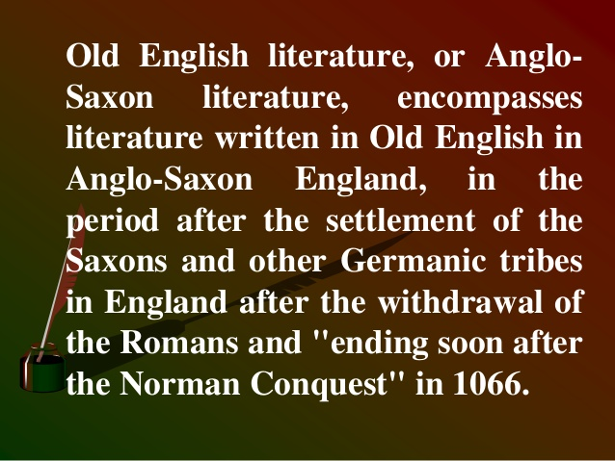

Slide 16
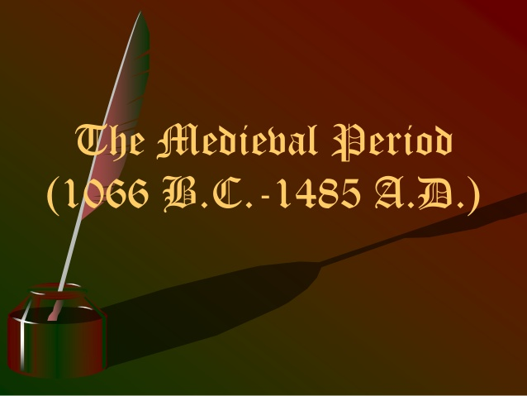

Slide 17
Prior to that time literature consisted primarily of religious writings but in the second half of 14th century produced the first great age of Secular « not religious »literature.
The best representetive is Geoffrey Chaucer the father of English literature.

Slide 18
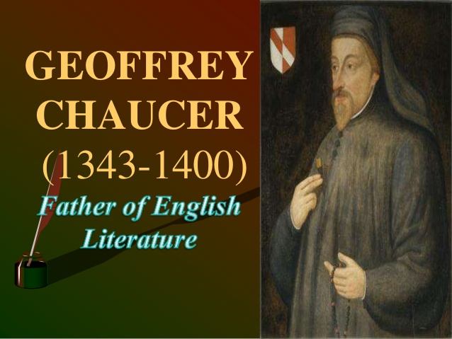

Slide 19
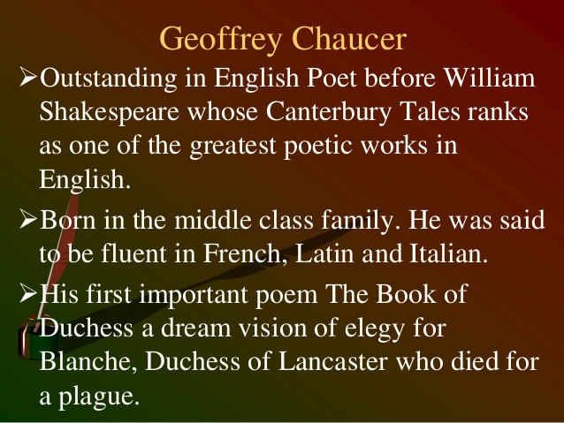

Slide 20
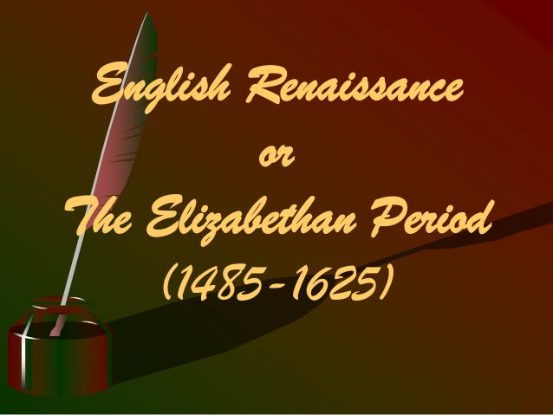

Slide 21
Three Periods
The Renaissance « 1485-1558 »
The Elizabethan period « 1558-1603 »
Jacobean period « 1603-1625 »

Slide 22
The Renaissance
Definition:is an intellectual ,artistic and literary movement that began in Italy « Florence »around 14th century and flourished in other European countries until 17th century.
The term Renaissance means « Rebirth »
Renaissance focuses o learning Greek and Roman traditions.

Slide 23
Elizabethan Period
Refers to refers to bodies of work produced during the reign of Queen Elizabeth I (1558–1603), and is one of the most splendid ages of English literature.
Italian literature was an important influence on the Elizabethan poetry.
William Sheakspear was a famous poet and playwright during this era

Slide 24
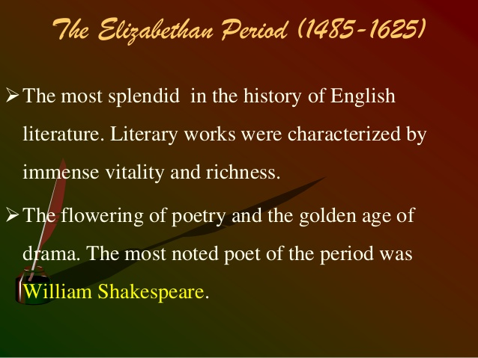

Slide 25
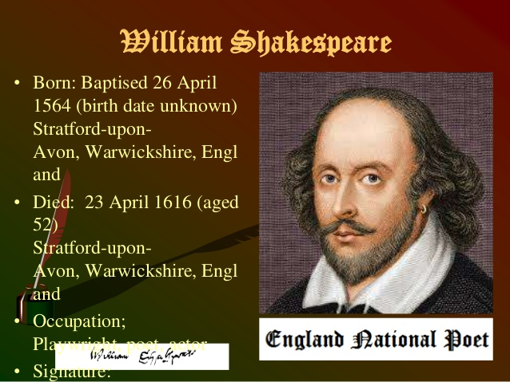

Slide 26
Jacobean period
The Jacobean Era refers to the period of time in which James I ruled England and Scotland, from 1603-1625. The word "Jacobean" comes from the Hebrew name Jacob, from which the name James is derived. Following the illustrious reign of Queen Elizabeth I
period is remarkable for its advances in literature and philosophy, and its dramatic changes to the nation

Slide 27
Literature and theater were of high importance in the Jacobean Era. William Shakespeare wrote Hamlet, Othello, King Lear, Macbeth, and The Tempest all within this period
he most significant works to the literature of the age. In 1604, the king ordered an English translation of the bible

Slide 28
Poetry
A type of literature that expresses ideas; feelings or tells story in a spesific form.
Poem: a piece of writing often having rhyme or rhytem which tells a story or describes a feeling.

Slide 29
