Slide 1
  Poetry

Slide 2
Poetry
What is it?
a type of literature that expresses ideas, feelings, or tells a story in a specific form

Slide 3
Elements of poem
Form: the appearance of the words on the page
Line: a group of words together on one line of the poem

Slide 4
The writer: in poetry the writer is called a poet.
Voice:the person who speaks or narrates the poem
The speaker and the poet are not necessiraly the same person
Theme:is the central idea that evolves within the poem.

Slide 5
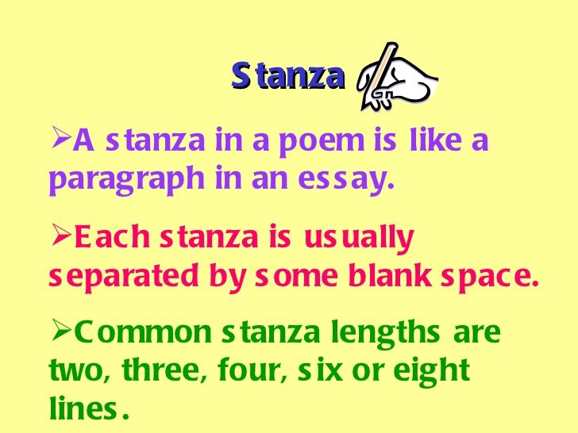

Slide 6
I Like My Nose
I’m glad that my nose
points down to my toes,
and doesn’t point up to the sky.
For now I can sneeze
just as much as I please,
without getting goo in my eye.
-Bruce Lansky

Slide 7
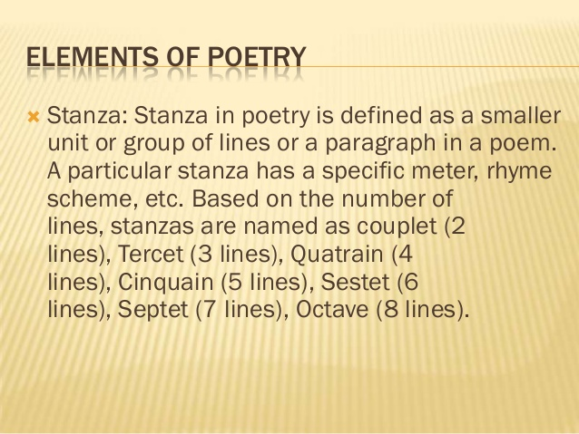

Slide 8
Example
« To a snowflake »
1 Hello little snowflake
2 Where are all your friends?
3 Should i expect a lot of them
4 Before the morning ends?
5 I love when you come to me
6 And you all fall down together,
7 And i get dressed to visit you
8 Toasty warm in cold , cold weater
The poem above has 8 Lines
The lines are organized into quatrians

Slide 9
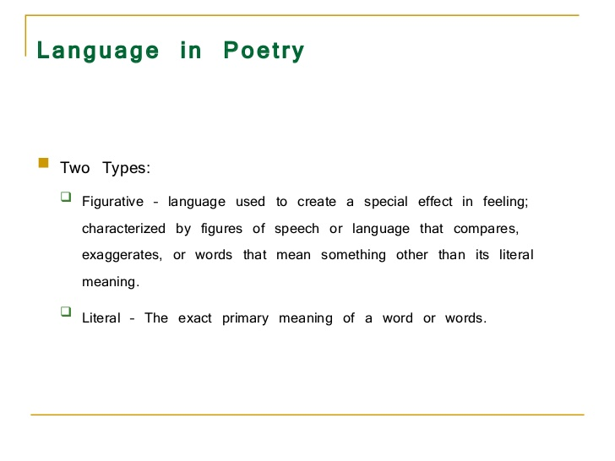

Slide 10
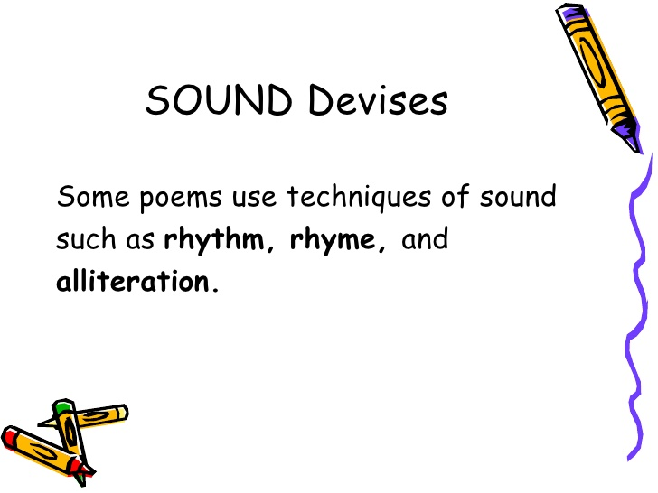

Slide 11
Feet: number of stressed and unstressed syllables in line.
The combination of feet creates meter in poetry .
Meter is the rhythemic structure of line in verse

Slide 12
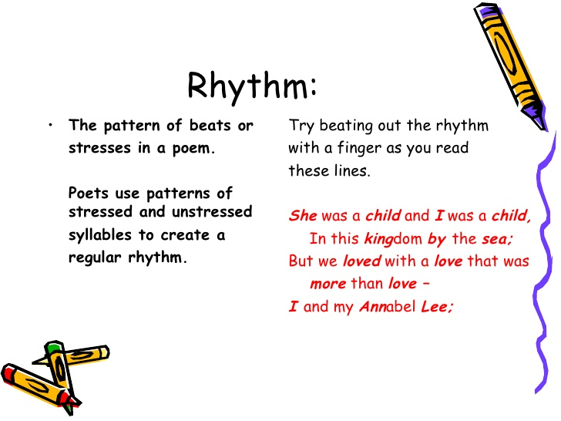

Slide 13
Types of Meter
Iamb: Combination of unstressed and stressed syllable – (daDUM) Eg Collapse
Trochee: Combination of stressed and unstressed syllables – (DUMda)Eg pizza lover
Spondee: Combination of two stressed syllables – (DUMDUM) Eg Football ,Breakdown
Anapest: Combination of two unstressed and a stressed syllable – (dadaDUM) Eg Understand
Dactyl: Combination of stressed and two unstressed syllables – (DUMdada) Eg Poetry
Pyrrhic: Combination of two unstressed syllables Eg And the

Slide 14
Types of feet
Monometer :with1 foot
Dimeter:2 feet
Trimeter :3 feet
Tetrameter:4 feet
Pentameter:5 feet
Hexameter: 6 feet
Heptameter: 7 feet
Octameter: 8 feet

Slide 15
Example
If music be the food of love, play on;
Give me excess of it, that, surfeiting,
The appetite may sicken, and so die.
That strain again! it had a dying fall;
O, it came o’er my ear like the sweet sound
William Sheakespear

Slide 16
Example 2
Dust of SnowRelated Poem Content Details
BY ROBERT FROST
The way a crow
Shook down on me
The dust of snow
From a hemlock tree
Has given my heart
A change of mood
And saved some part
Of a day I had rued.

Slide 17
Rhyme
Words rhyme when they have the same sound.
Poems often use rhyme at the end of lines.
Poets use rhyme to add a musical sound to their poems.

Slide 18
Example
« Ten Minutes Till the Bus»
Ten whole minutes
Till the bus, A
Scads of time,
What’s the fuss? A
Two to dress
One to flush B
Two to eat
One to brush , B
That leaves four
To cutch the bus, A
Scads of time,
What’s the fuss A

Slide 19
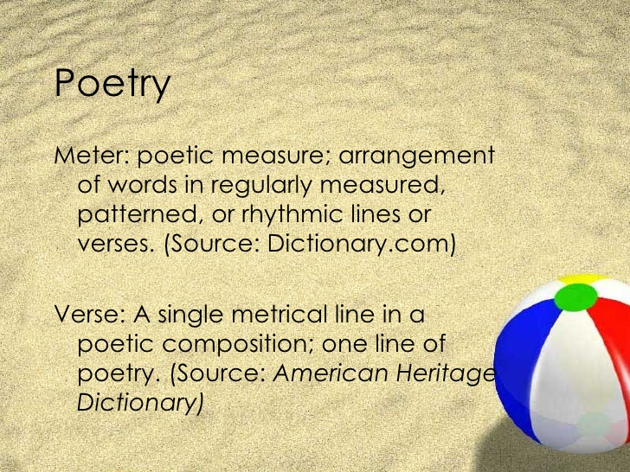

Slide 20
Rhyme
Words sound alike because they share the same ending vowel and consonanat sounds.
EX: Lamp/ Stamp

Slide 21
End Rhyme: a word at the end of of one line rhymes with a word at the end of another line.
EX: Hector the collector
collected bits of string
Collected dolls with broken heads
And Rusty bells that would not ring
Internal rhyme: A word inside a line rhymes with another word on the same line
EX:Once upon a midnight dreary , while i pondered ,weak and weary

Slide 22
Rhyme Scheme
Heavy is my heart, A
Dark are thine eyes B
Thou and I must part A
Ere the sun rise B

Slide 23
ALLITERATION
Consonant sounds repeated at the beginnings of words
If Peter Piper picked a peck of pickled peppers, how many pickled peppers did Peter Piper pick?
Notes:
Activity: Alliteration group game

Slide 24
Imagery
•Representation of the five senses: sight, taste, touch, sound, and smell
•Creates mental images about a poem’s subject
• Example: “Continuous as the stars that shine and twinkle on the milky way”

Slide 25
Mood
Is the general feeling or atmosphere that a piece of writing creates within the reader

Slide 26
Repetition
•A word or phrase repeated within a line or stanza •
• Example: “gazed and gazed”

Slide 27

Symbol
•A word or object that has its own meaning and represents another word, object or idea •
• Example: The daffodils represent happiness and pleasure to the author.

Slide 28
Figurative Language
Metaphor
  Direct Metaphor
  Implied Metaphor
Simile
Personification

Slide 29


Metaphor
Direct Metaphor
Comparing two unlike objects or ideas
My love is a rose

Slide 30
Metaphor, Continued
Indirect metaphor
- An indirect comparison between two unlike things.
“My love has a rosy bloom”

Slide 31
Personification
Giving human qualities to an inanimate object
“The moon smiled down on the lovers”

Slide 32

Simile
A comparison using like or as
“Life is like a box of chocolates”
She is as beautiful as a sunrise
Usually comparing 2 unlike things
My love is like red rose

Slide 33
Onomatopoeia
Onomatopoeia is the use of words that imitate sounds.
Wham! Splat! Pow! I am in trouble now!

Slide 34
Refrain
A sound , word, phrase or line repeated regularly in a poem

Slide 35
Types of Poems

Slide 36
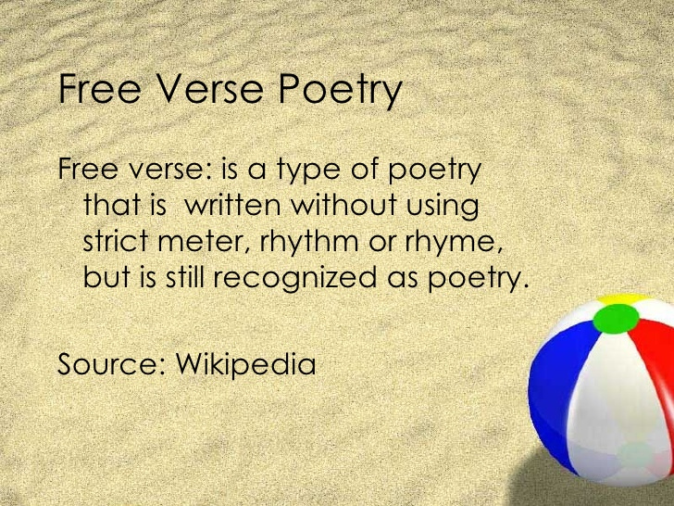

Slide 37
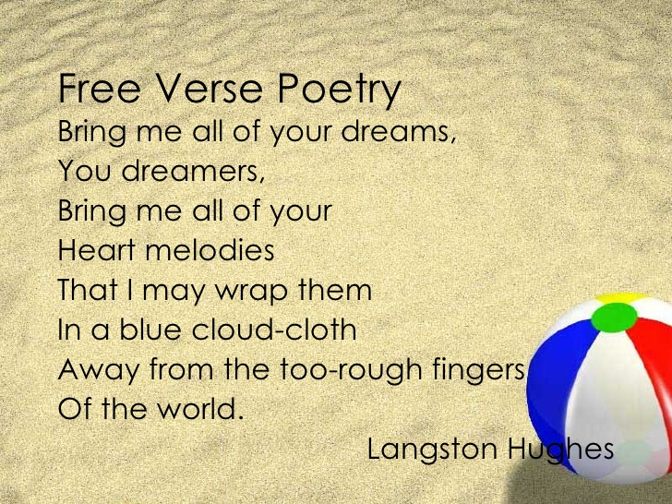

Slide 38
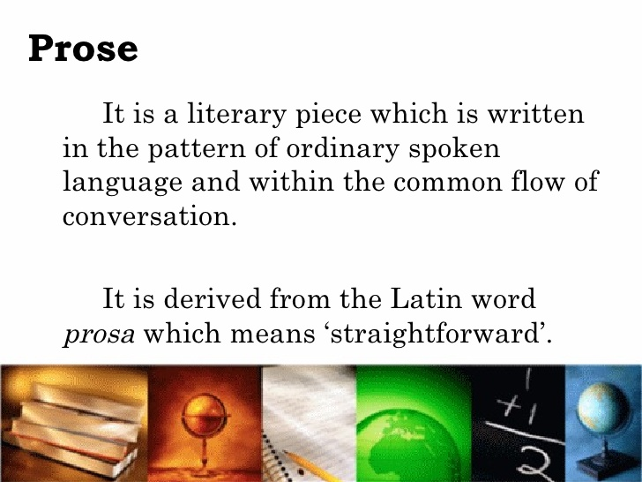

Slide 39
Prose
Definition: From latin word Prosa means Straightfoward speech/ a natural flow of speech.
written language in its ordinary form rather than in the form of poems
the ordinary form of spoken or written language, without metrical structure, as distinguished from poetry or verse.
he word "prose" first appears in English in the 14th century.

Slide 40
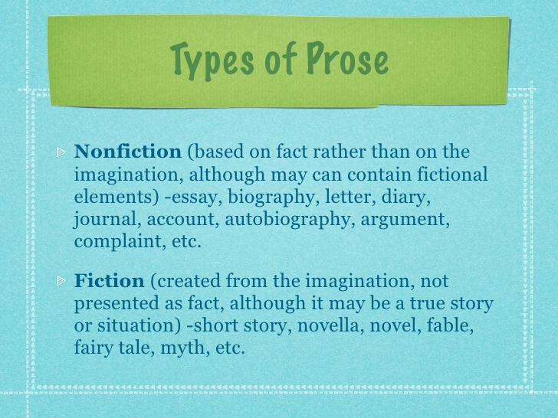
Types of Prose

Slide 41
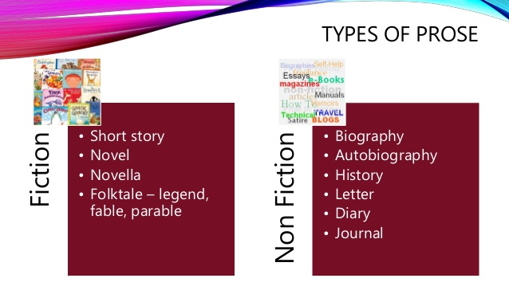

Slide 42
Elements of fiction
Fiction: a story invented from a writer’s imagination.
Fiction contains 5 main elements :
1.Plot
2.Character.
3.Conflict
4.Theme
5.Setting

Slide 43
Plot
The Sequence of events in the story.
The plot of story shows the sequence ( order) in which the events of the story occur
beginning
Middle
End

Slide 44
Conflict
The struggle between two forces.
Plot is usually built around a central conflict ,which is the main problem in a story.

Slide 45
Characters
Can be
People ; animals or creatures who take part in the action of the story
Pretagonist: the main character in a story
Antagonist :The character or the force working against the pretagonist.

Slide 46
Theme
The central idea or lesson about life an author wants his /her reader to understand .
The theme is rarely stated in the story means yu have to infer what the theme is
Infer: Educated guess.

Slide 47
Point of view
Definition: The direction from which the writer has chosen to tell the story

Slide 48
Setting
Is the time ;place and duration of a story
Setting tells when, where , and how long

Slide 49

Short Story
Definition: Fictional story that can be read in one sitting.
  Example: “A Rose for Emily,” “The Cask of Amontillado,” or “The Most Dangerous Game”

Slide 50
First Person: One of the characters tells the story; talks directly to the reader
  Uses the pronoun “I,” “me,” “we,” or “us”
Third Person Limited: The narrator will focus on the thoughts & feelings of just one character
  - Reader experiences the events of the story through the memory and senses of only one character

Slide 51
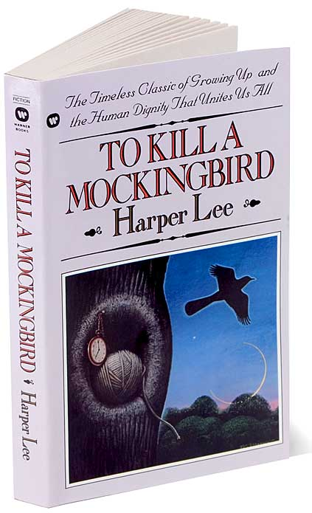
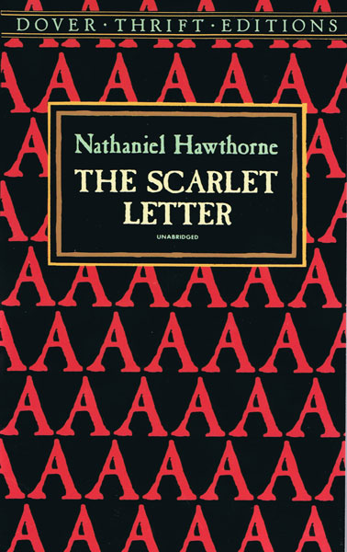
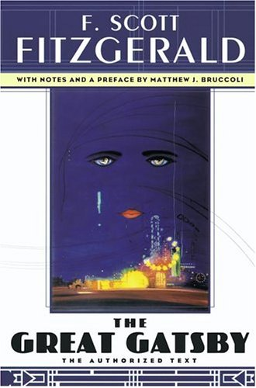
Novel
Definition: A long prose narrative that must be read in many sittings.
  Example: To Kill a Mockingbird, The Scarlet Letter, or The Great Gatsby

Slide 52
